Slide 1
The failure of PKI
Certificate Transparency
(with insights on hash based data structures, specifically Merkle trees)

Slide 2
a VERY SERIOUS real world problem: fake certificates

Slide 3
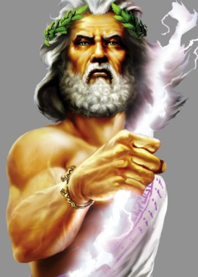


Web security pillar: Certificate Authorities ARE trusted!
UNIVERSETRUST
LUNATRUST
https://www.google.it
CERTIFICATE(I am google)_{LUNATRUST}

Slide 4
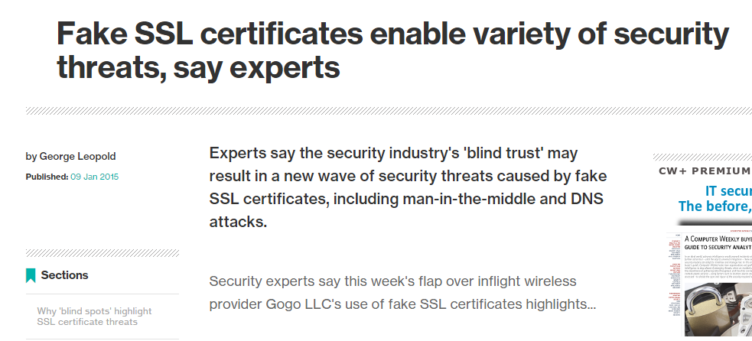
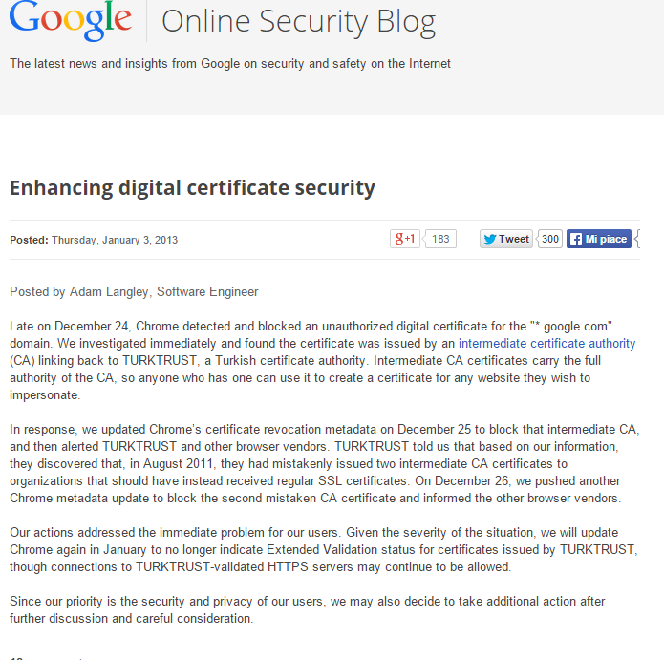
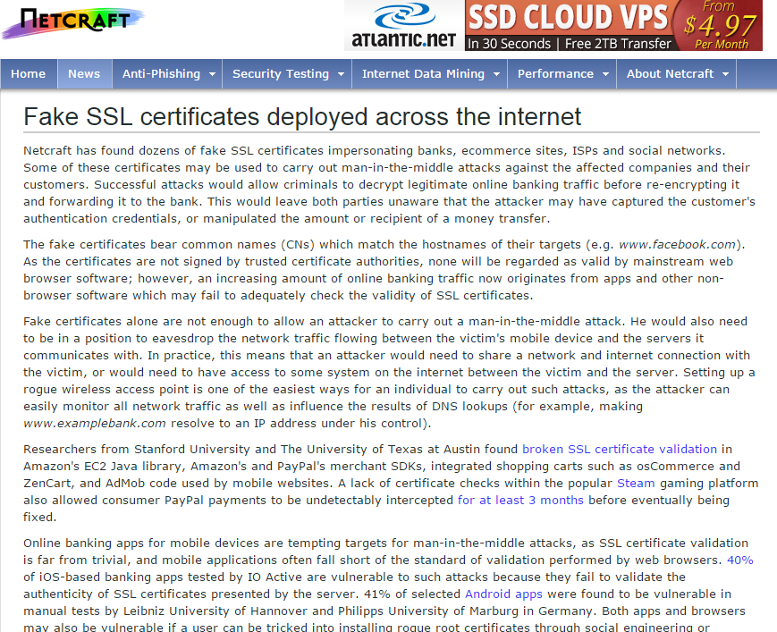
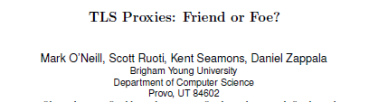
Fact: trusted CA assumption at stake
Google’s VALID fake Certificates mistakenly (?) issued
by TurkTrust (2012), ANSSI France (2013), etc
Smaller CAs: compromised
Holland: Dgnotar
Malaysia: DigiCert sdn. Bhd.
etc

Slide 5
A serious problem
Fake VALID certificates
Variuous small/moderate CA «releasing» valid certificates for major sites
Asked by governments? Mistakenly… lost?
Many cases: google fake certificates issued by
Turkey’s Turktrust, December 2012
ANSSI in France on December 2013
etc
Conmpromised CAs
Holland: DGnotar
Malaysia: DigiCert sdn. Bhd.
etc
With powerful threats (governments), and many players which can «make mistakes» the security of the PKI model is getting weaker and weaker

Slide 6


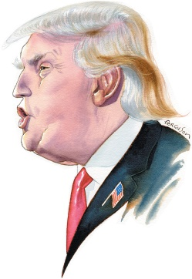
How to cope with malicious CAs? Idea: gigantic worldwide DB which anyone can check!
Certificate Transparency DB
UNIVERSETRUST
LUNATRUST
They are using my name!
https://www.google.it
CERTIFICATE(I am google)_{LUNATRUST}
Fake!!

Slide 7
How to implement such gigantic Database of certificates?
A parethesis: Merkle Trees

Slide 8
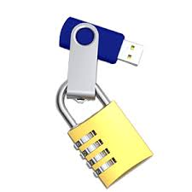
How to secure a file (when you don’t have a large secure storage available)
FILE
long msg!
Step 1: make “fingerprint” of the file
Via a cryptographic hash function
large file → small fingerprint!
Step 2: “secure” the fingerprint!
By copying it in a secure storage
… or…
By digitally signing the hash fingerprint
H(FILE)
H(FILE)
H(FILE)

Slide 9
What about «chunked» messages?
VERY LONG MESSAGE
SIGNATURE
Peer-to-peer delivery
Message divided into independent chunks
Frequently received out of order, and from distinct peers
Signature verification: needs to wait until COMPLETE message reconstruction
But what about fake injected chunks?
…
CHUNK 1
CHUNK 2
CHUNK 3
CHUNK 4
CHUNK N

Slide 10
What about «partial» verification?
VERY LONG MESSAGE / DB
SIGNATURE
Part A
Part B
…
Part GB
…
SIGNATURE
Only part to be verified
Signature verification: need to retrieve the whole database??

Slide 11
Per-chunk signatures?
CHUNK 1
SIG1
CHUNK 2
SIG2
CHUNK N
SIG-N
OK but…
Computational overhead
Signature = anymmetric crypto = o(1000+) x hash computation cost
Storage overhead
RSA2048 = 256 bytes
Bitcoin’s ECDSA256 = 2 x 256 bit = 64 bytes
still quite a lot f you need MANY of them (small chunks)
No more integrity check for whole file (strip-type attacks)
CHUNK
SIG
CHUNK
SIG
CHUNK
SIG
CHUNK
SIG
CHUNK
SIG
CHUNK
SIG

Slide 12

Per-chunk signatures?
CHUNK 1
SIG1
CHUNK 2
SIG2
CHUNK N
SIG-N
OK but…
Computational overhead
Signature = anymmetric crypto = o(1000+) x hash computation cost
Storage overhead
RSA2048 = 256 bytes
Bitcoin’s ECDSA256 = 2 x 256 bit = 64 bytes
still quite a lot f you need MANY of them (small chunks)
No more integrity check for whole file (strip-type attacks)
CHUNK
SIG
CHUNK
SIG
CHUNK
SIG
CHUNK
SIG
CHUNK
SIG
Can we find
a better solution?
CHUNK
SIG
Ops… did I receive all?

Slide 13
Merkle’s idea: Hash tree
Digitally signed
ROOT = H( H{H[H(A),H(B)],H[H(C),H(D)]} , H{H[H(E),H(F)],H[H(G),H(H)]} )
H{H[H(A),H(B)],H[H(C),H(D)]}
H{H[H(E),H(F)],H[H(G),H(H)]}
H[H(A),H(B)]
H[H(C),H(D)]
H[H(E),H(F)]
H[H(G),H(H)]
H(A)
H(B)
H(C)
H(D)
H(E)
H(F)
H(G)
H(H)
A
B
C
D
E
F
G
H

Slide 14
Single chunk verification: use “siblings”
ROOT = H[C3, S3]
C3 = H{S2,C2}
S3 =H{H[H(E),H(F)],H[H(G),H(H)]}
S2 = H[H(A),H(B)]
C2=H[C1,S1]
H[H(E),H(F)]
H[H(G),H(H)]
H(A)
H(B)
C1=H(C)
S1 = H(D)
H(E)
H(F)
H(G)
H(H)
A
B
C
D
E
F
G
H
Log(N) siblings needed

Slide 15
Extending merkle’s trees w. time
ROOT5
ROOT4
Root TS5
ROOT3 = H[*,*]
Root TS4
ROOT2 = H[*,*]
ROOT = H[*,*]
ROOT = H[*,*]
ROOT = H[*,*]
H[*,*]
H[*,*]
H[*,*]
H[*,*]
H[*,*]
H[*,*]
H[*,*]
H[*,*]
H[*,*]
H[*,*]
H[*,*]
H[*,*]
H[*,*]
H[*,*]
H[*,*]
H[*,*]
H[*,*]
H[*,*]
H(A)
H(B)
H(C)
H(D)
H(E)
H(F)
H(G)
H(H)
H(A)
H(B)
H(C)
H(D)
H(E)
H(F)
H(G)
H(H)
H(A)
H(B)
H(C)
H(D)
H(E)
H(F)
H(G)
H(H)
A
B
C
D
E
F
G
H
A
B
C
D
E
F
G
H
A
B
C
D
E
F
G
H
Time-slot 1
Time-slot 2
Time-slot 3
VALIDATION:
Siblings for «your» tree
+ root ot previous timeslot
+ roots ot next timeslots

Slide 16
Merkle trees and blockchains
0000000
H[ ]
H[ ]
Merkle Tree Root 1
Merkle Tree Root 2
Merkle Tree root 3
transaction
transaction
transaction
transaction
transaction
transaction
transaction
transaction
transaction
H[ ] H[ ]
Transaction can be verified without downloading content of block
[Merkle tree root stored in block header]
H[ ] H[ ]
H[ ] H[ ]
Trans A
Trans B
Trans C
Trans D

Slide 17
Merkle Trees: Applications
Efficient storage in blockchains
Bitcoin, Ethereum, etc
Used in many parts of many blockchains!
Google’s Certificate transparency
File Chunk validation
And many more
One-time signatures
Node authentication
Memory & storage authentication
Signature spreading
…. Etc etc …

Slide 18
Merkle Trees’ application:
Certificate Transparency

Slide 19
How to cope with malicious CAs? Idea: gigantic worldwide DB which anyone can check!
Certificate Transparency DB
UNIVERSETRUST
LUNATRUST
They are using my name!
https://www.google.it
CERTIFICATE(I am google)_{LUNATRUST}
Fake!!

Slide 20
Why certificate transparency?
Make it almost impossible for a CA to issue a SSL certificate for a domain without the certificate being visible to the owner of that domain.
Idea: put all certificates in a gigantic public list, that everyone can access and consult
Further idea: make sure that we all see the “same” list!!
New threat: “split world”: the public list you see is different (and crafted!) from what the rest of the world sees

Slide 21
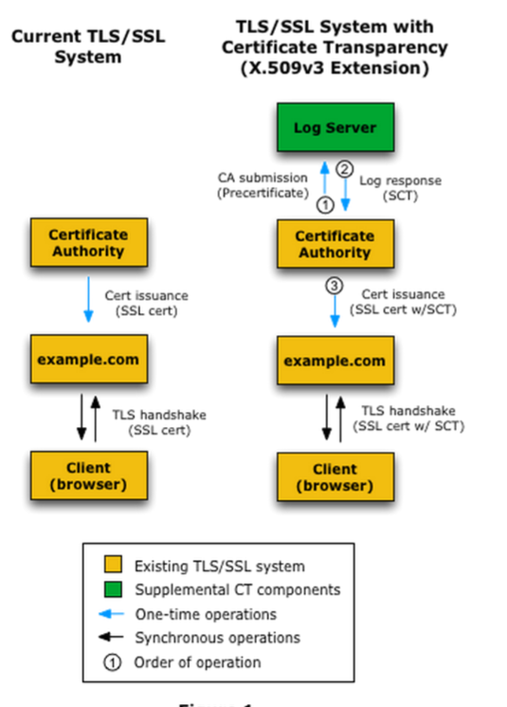
Certificate Transparency in a nutshell
When issuing certificate: add it to the log server
Returns a Signed Certificate Timestamp (SCT)
During TLS handshake:
Check certificate validity (as usual)
Follow up with an additional Extended Validation (EV) by verifying that the certificate is in the public list

Slide 22
Certificate Transparency
Google’s initiative
started 2013
First stated in experimental RFC 6962
July 2013
Endorsed and supported by IETF WG «trans»
Goal: standardize CT
RFC 6962bis released in December 2014
Integrated in major browsers
Chrome 1+, IE7+, Firefox 3+, Safari 3.2+, Opera 9.5+
Although not yet consistently used by all web sites
Supported by major sites
Paypal, CertSign, etc
Multiple pilot logs
Google, Cloudflare, DigiCert, etc
https://certificate.transparency.dev/logs/

Slide 23
CT: how it works?
Uses Merkle trees!
Very scalable, log(n) verification complexity
A special type (sometimes called chron tree)
«append only» Merkle tree
Timestamped entries
Cannot retroactively insert a certificate
Following figures: source http://www.certificate-transparency.org/log-proofs-work

Slide 24
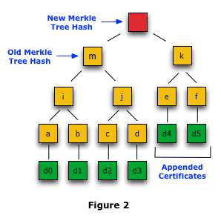
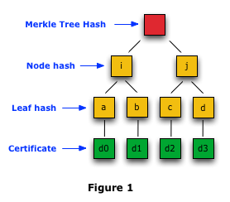
CT: how it works?
Every X hours, tree updated (currently X=24h)

Slide 25
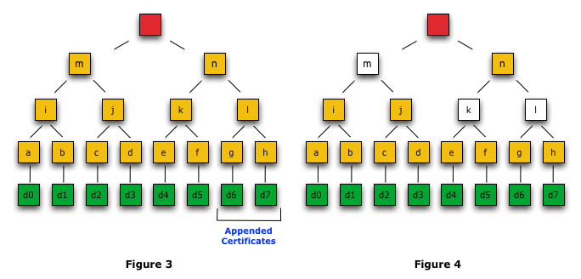
Merkle Consistency proof
Verify that two versions of a log are consistent (i.e., the later includes everything of the earlier).
Consistency proof → no certificates have been modified or back-dated and inserted into the log.
Proof = need only root of the subtrees – includes past “root”

Slide 26
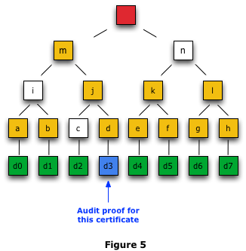
Merkle Audit Proof
Usual: via certificate + siblings
Siblings obtained from log
Issue: online operation, visible to all…
Remember who are the threats today…
Alternative: use «gossiping» protocols
Work in progress @ 2015!
No time for (very nice) details…

Slide 27
Certificate Transparency in the real world
Lauched in july 2013 by Google
experimental IETF RFC 6962
IETF WG «trans»
Specified processes and protocols
Integrated in all major browsers
Supported by major sites
Paypal, CertSign, etc
Multiple pilot logs
Google, Cloudflare, DigiCert, etc
https://certificate.transparency.dev/logs/

Slide 28
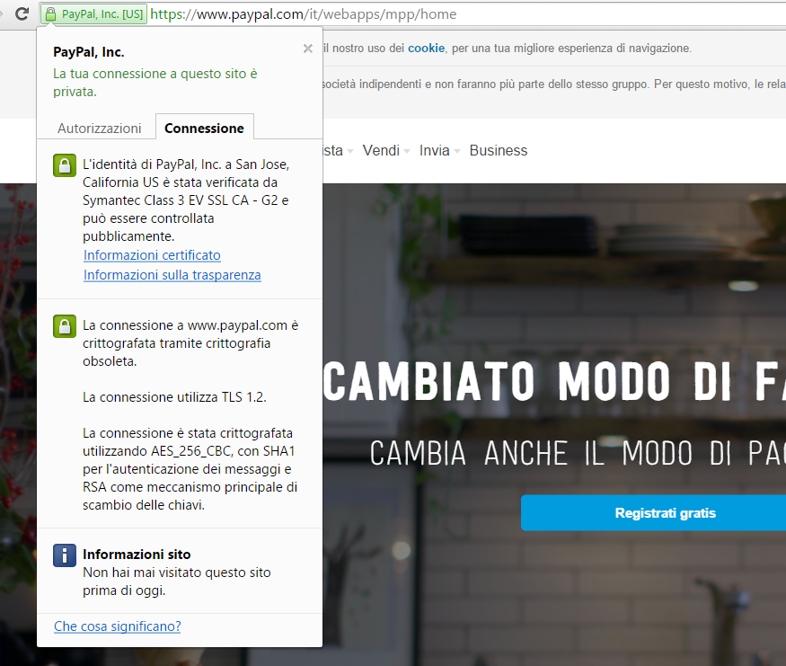
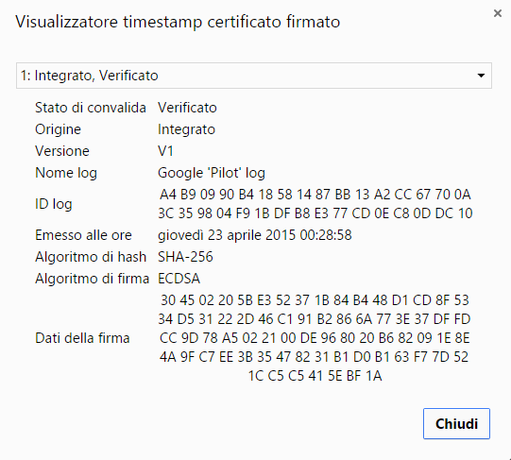
EV in the real world

Slide 29
Common misconception: Cert Trans is a Blockchain?
It definitely looks like
Identical (!) architecture as Bitcoin’s ledger
It could be distributed as well
Instead of different logs, make it a same «consensus» log
But it is NOT a Blockchain
It does NOT necessarily contain only VALID certificates!
As a Blockchain mandates; also Google being crystal clear on this!
Blockchain
If stored,
NOT fake!
CERT

Slide 30
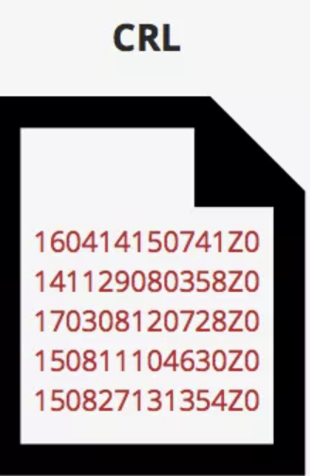
Cert Trans → is a Blockchain?
It definitely looks like
Identical (!) architecture as Bitcoin’s ledger
It could be distributed as well
Instead of different logs, make it a same «consensus» log
But it is NOT a Blockchain
It does NOT necessarily contain only VALID certificates!
As a Blockchain mandates; also Google being crystal clear on this!
Security comes from transparency
Certificate Transparency DB
If NOT stored,
Then it IS fake!
Fake Google cert?
Revoke it!
But if stored,
Could still be fake!
Check revocation!
CERT

